Slide 1
Spectral Graph Approximation
Clemens Damke
Intelligent Systems and Machine Learning Group
ISML Seminar, July 2019

Slide 2
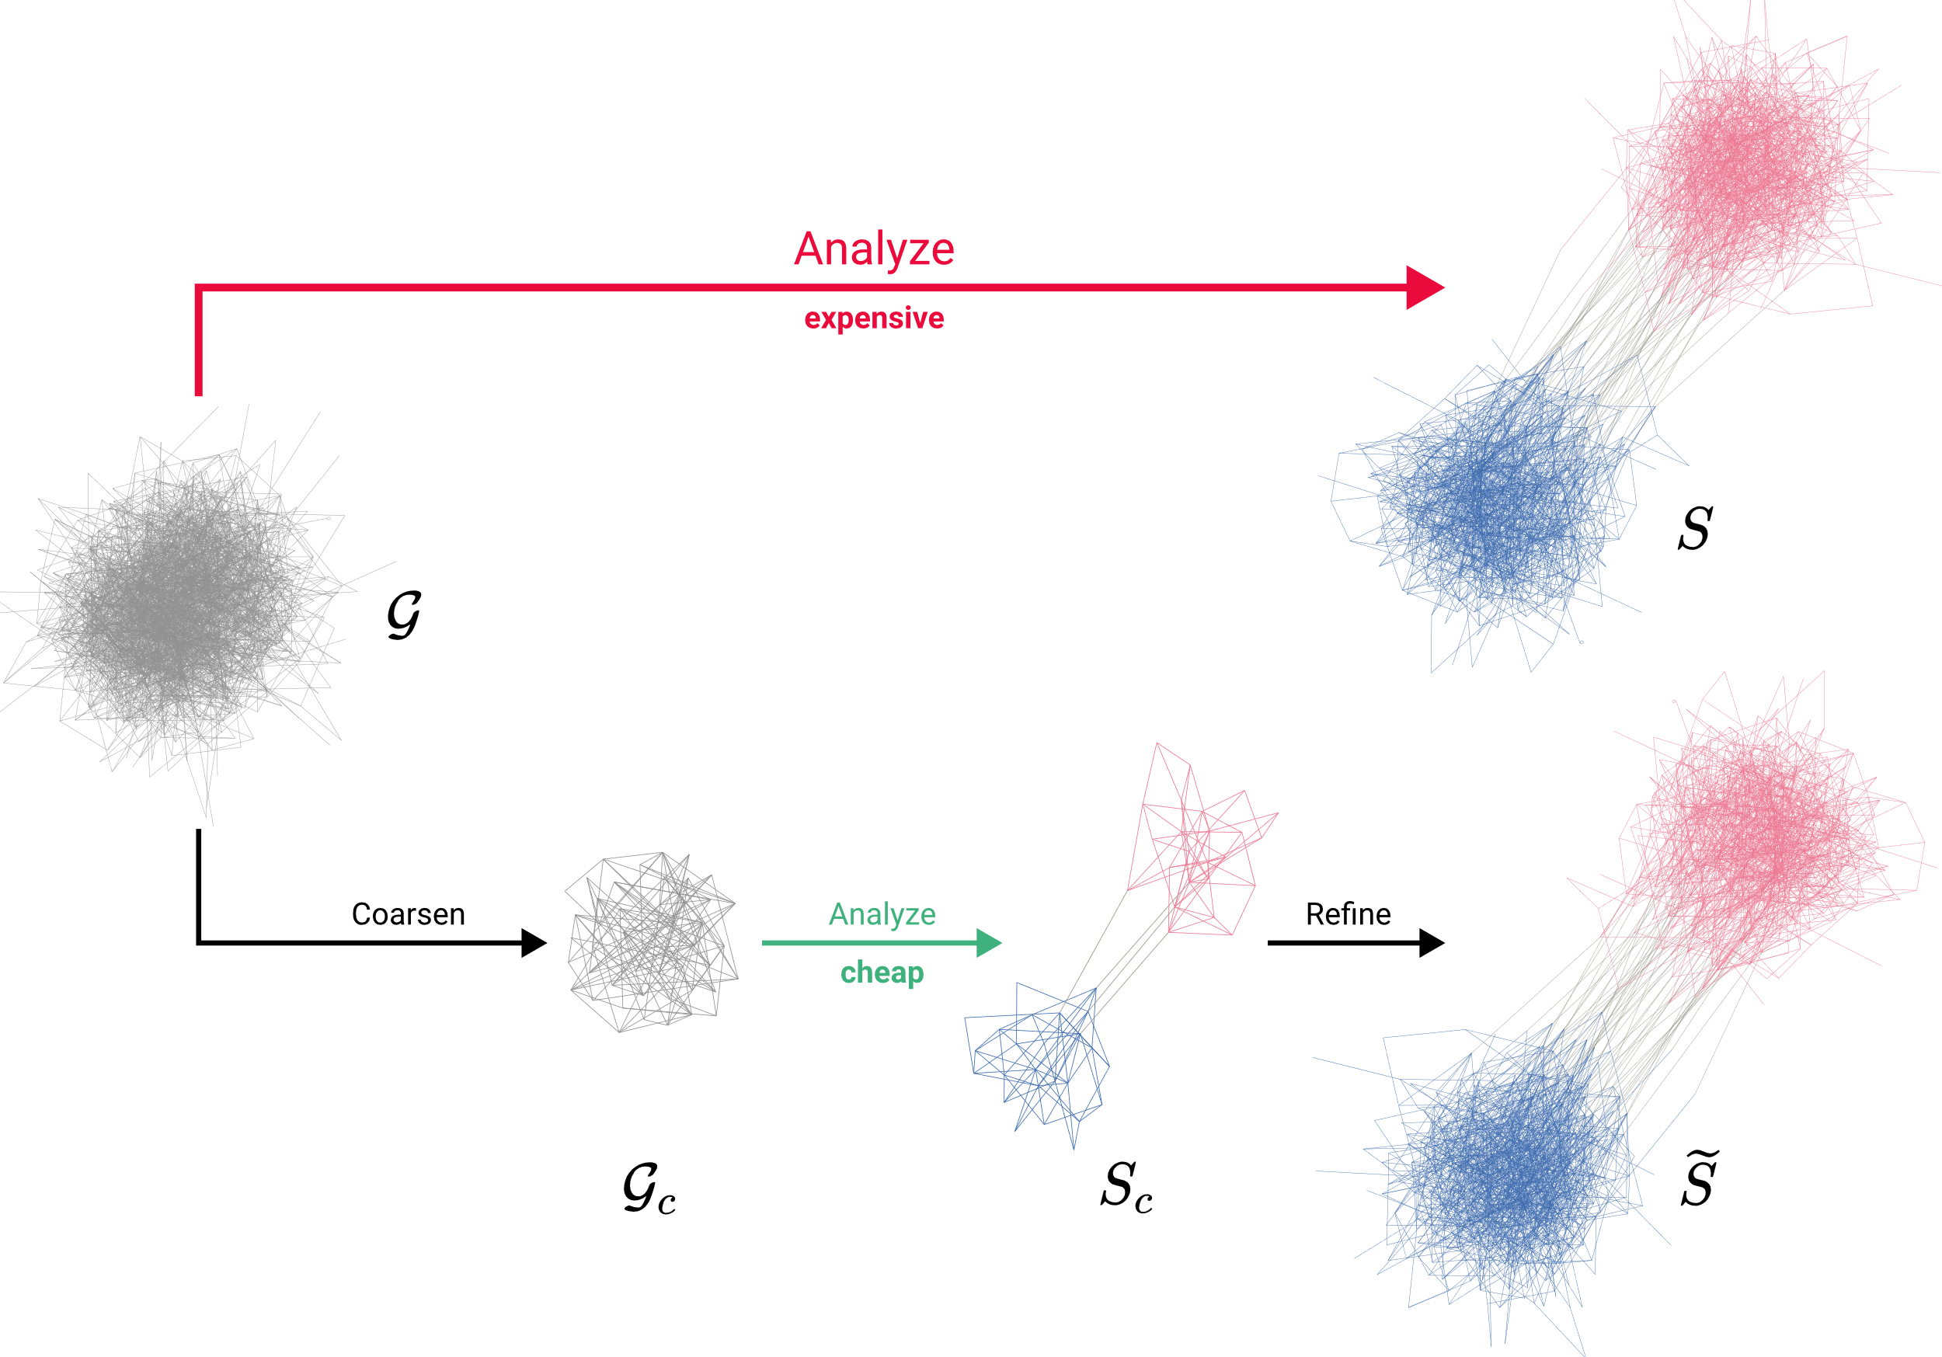
MOTIVATION

Slide 3
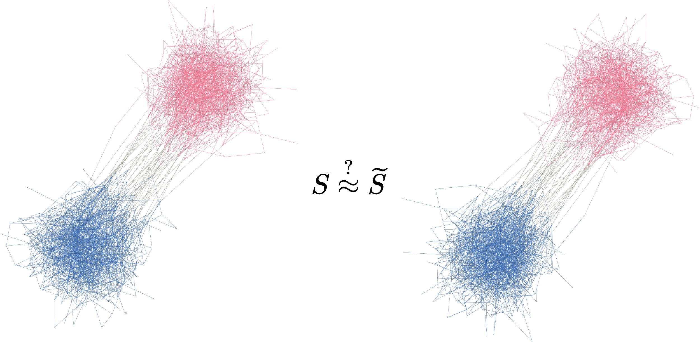
MOTIVATION
What is the effect of coarsening?

Slide 4
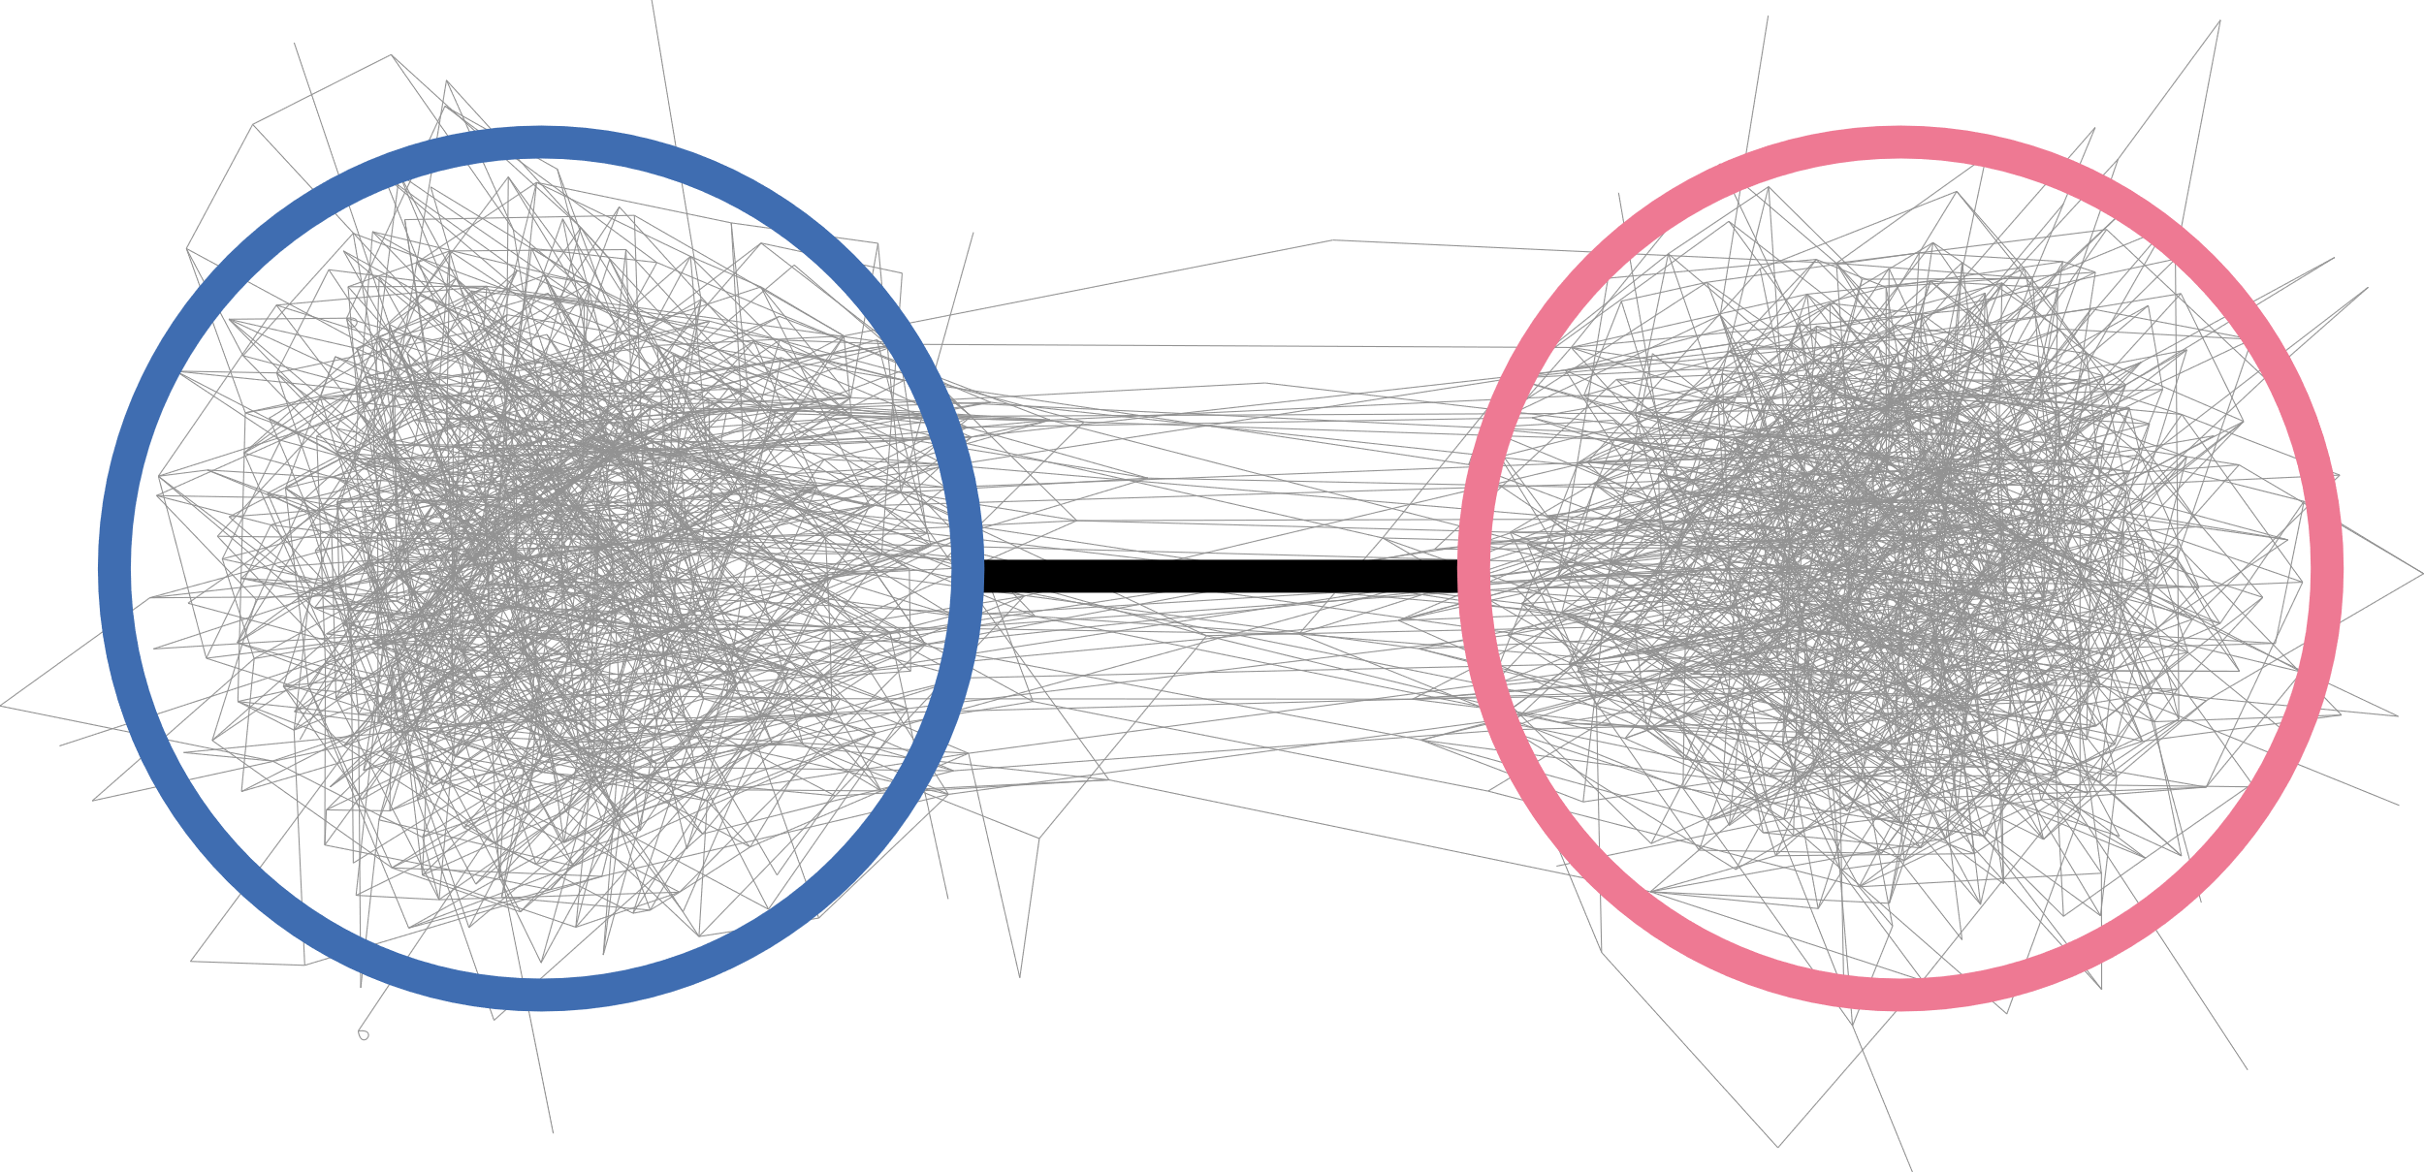
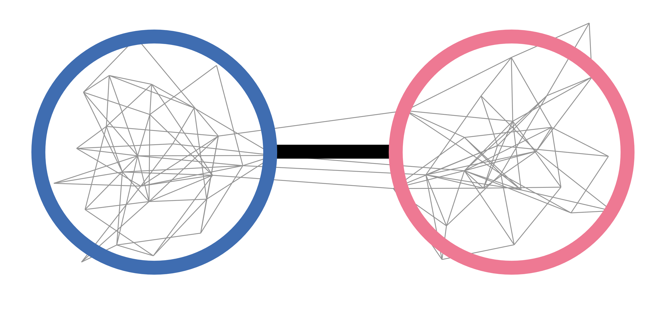
OVERVIEW
1. How to describe a graph‘s overall structure?
2. How to coarsen a graph?
3.
What is the effect of coarsening?

Slide 5
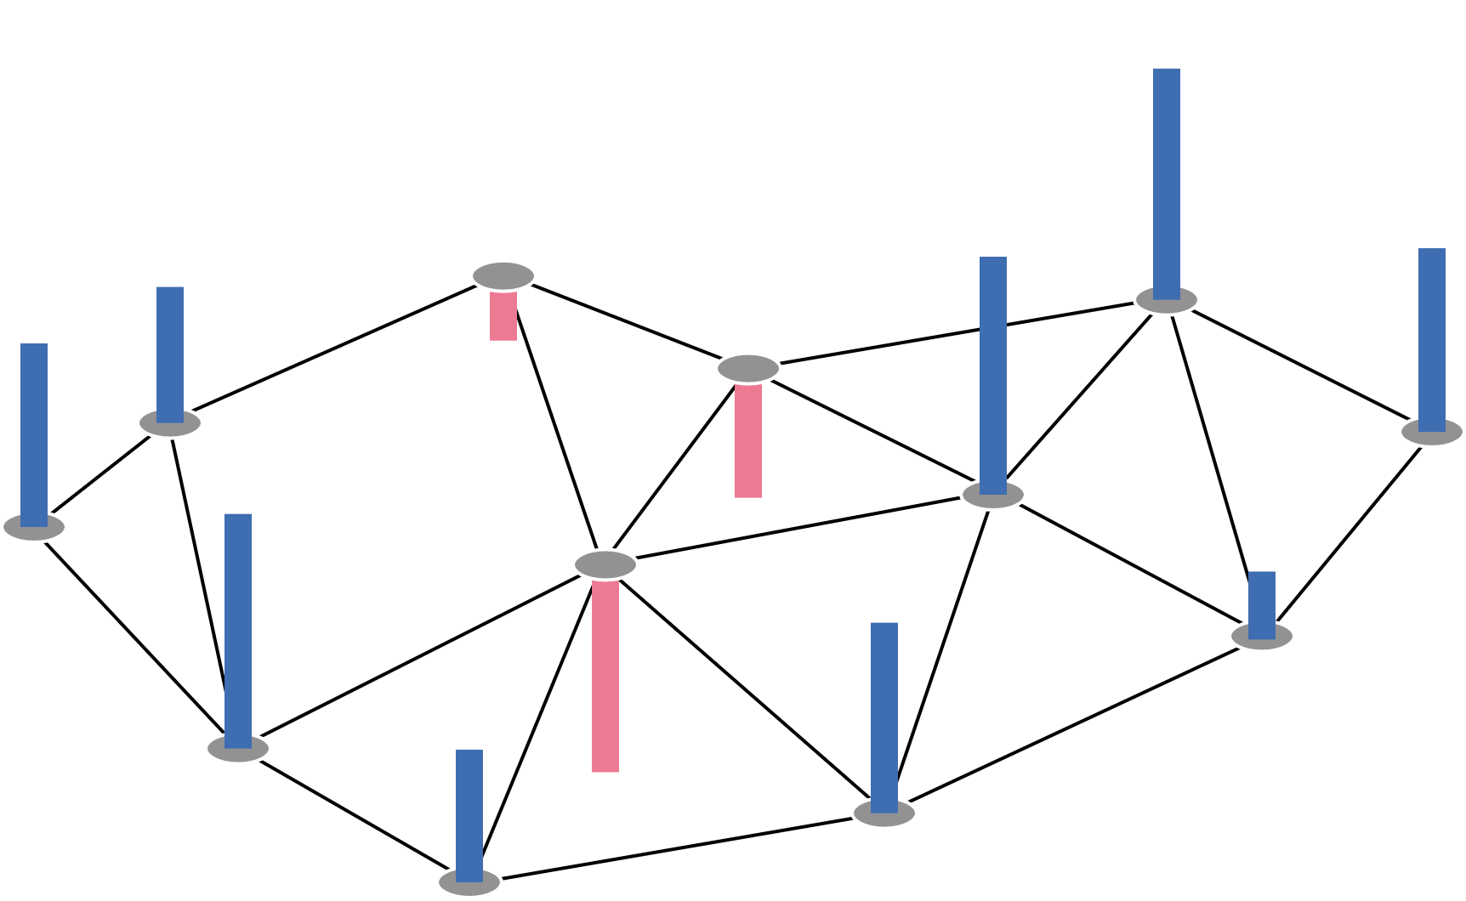
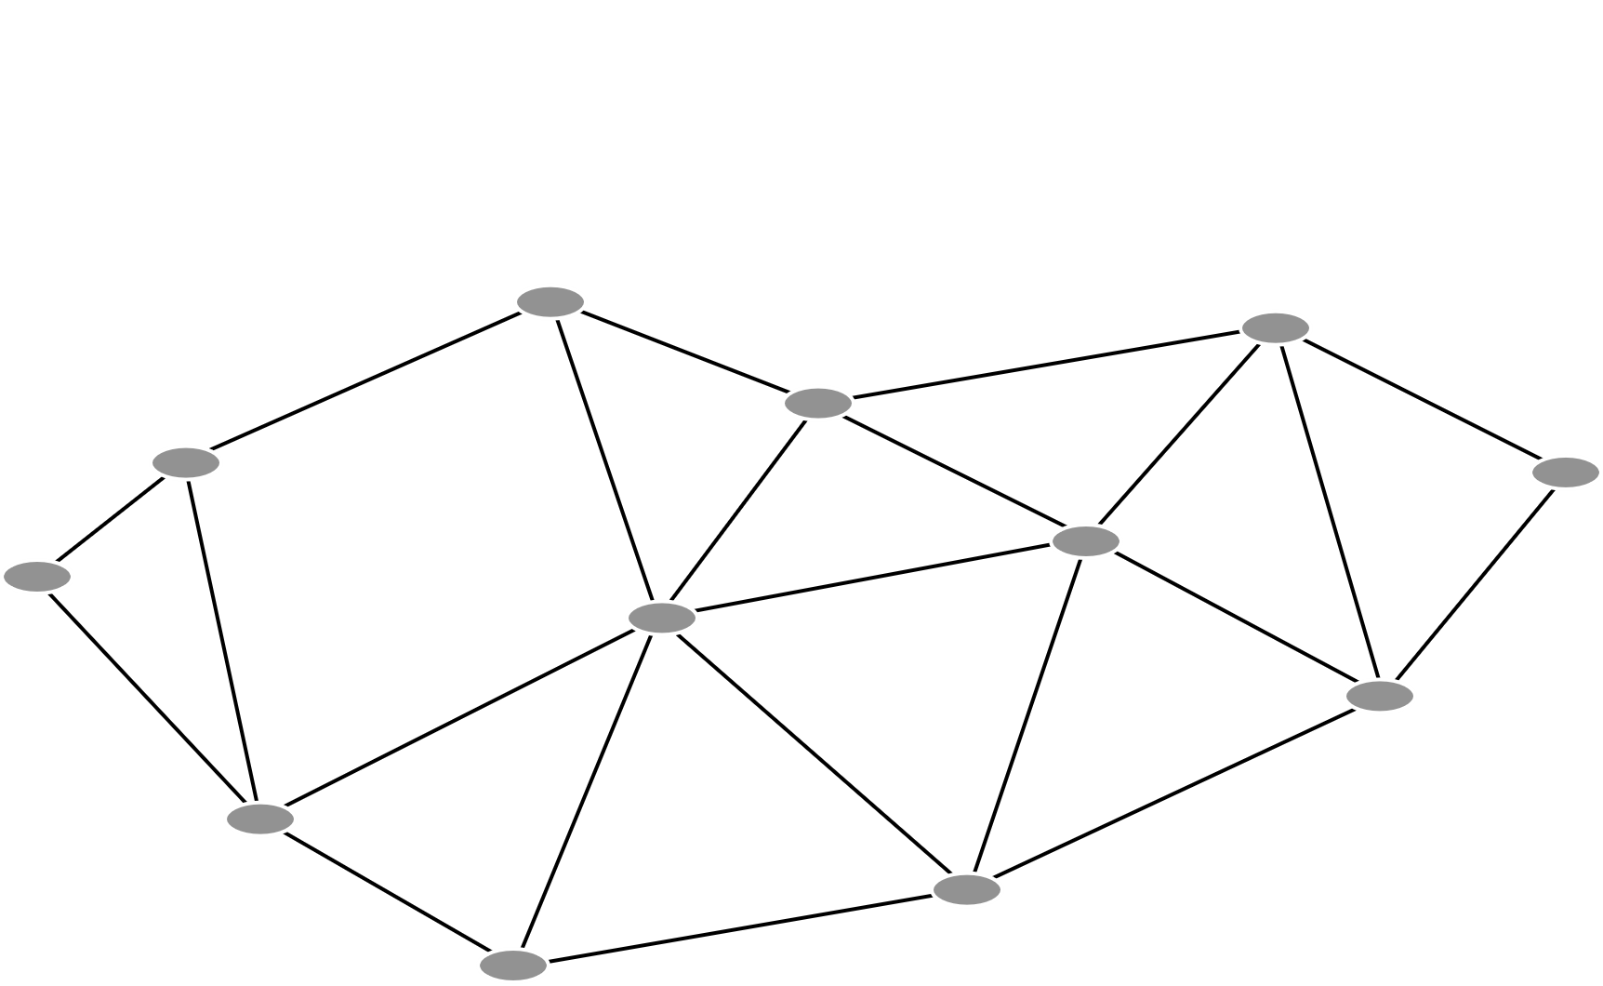
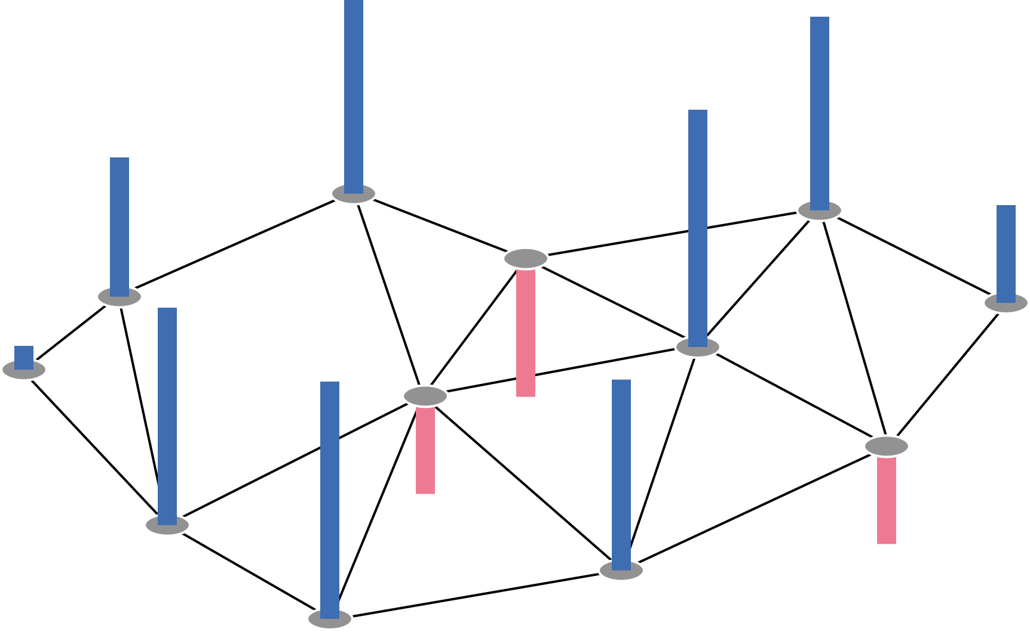
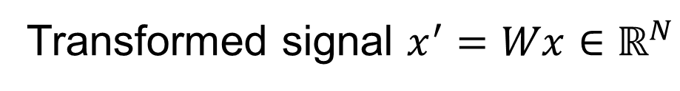
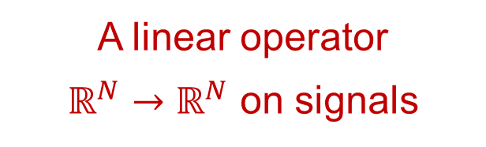

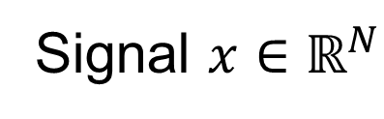
1. SPECTRAL GRAPH THEORY: Graphs as Linear Operators
$$𝒢 :=\left(𝒱, ℰ,W∈ℝ^{N×N}\right)$$
A linear operator
$ℝ^{N}→ℝ^{N}$ on signals
Transformed signal $x^{′}=Wx∈ℝ^{N}$
Signal $x∈ℝ^{N}$

Slide 6

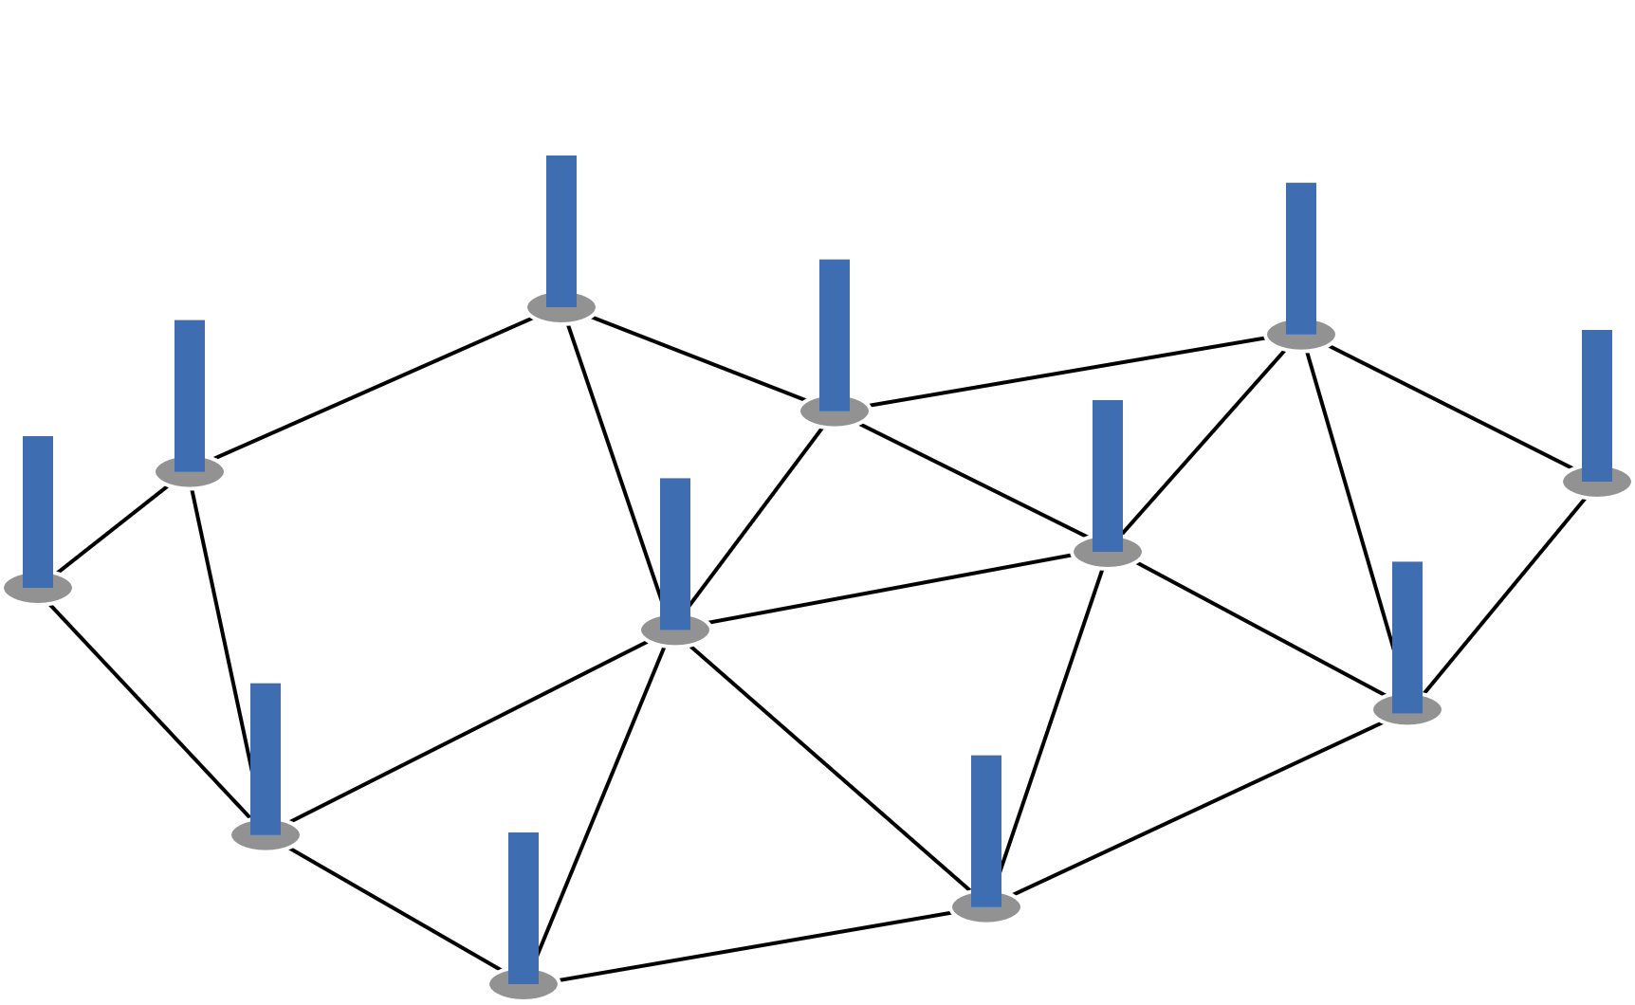
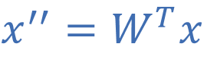
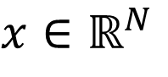
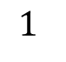

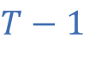
1. SPECTRAL GRAPH THEORY: Signals as Heat Distributions
Equilibrium
$$1$$
$$T−1$$
Heat Flow
$$x∈ℝ^{N}$$
$$x^{′}=Wx$$
$$x^{′′}=W^{T}x$$
Described by the Fourier Transform

Slide 7
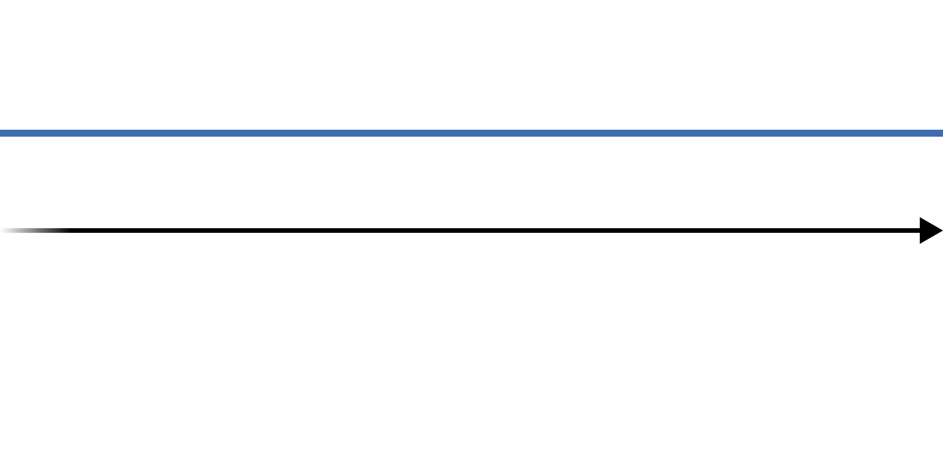
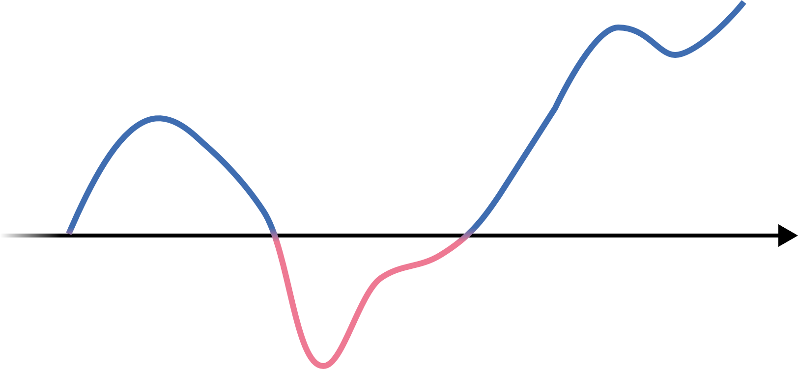
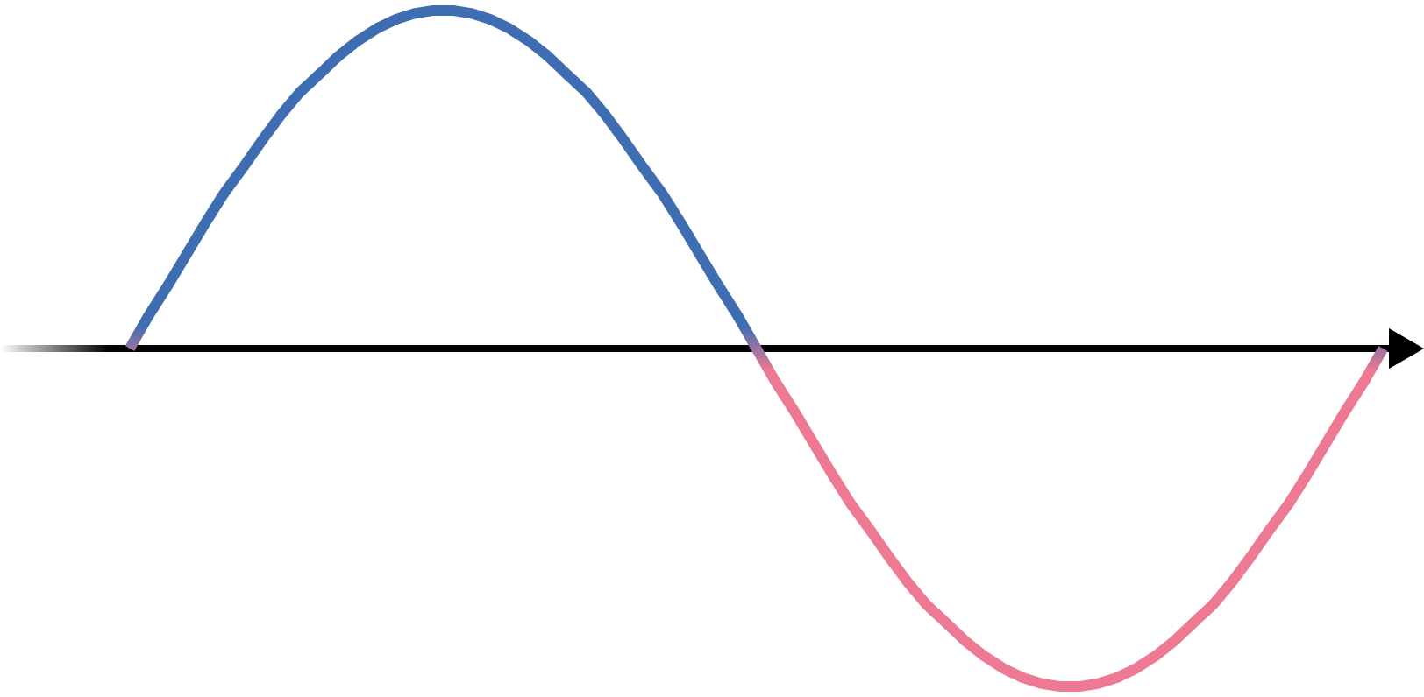
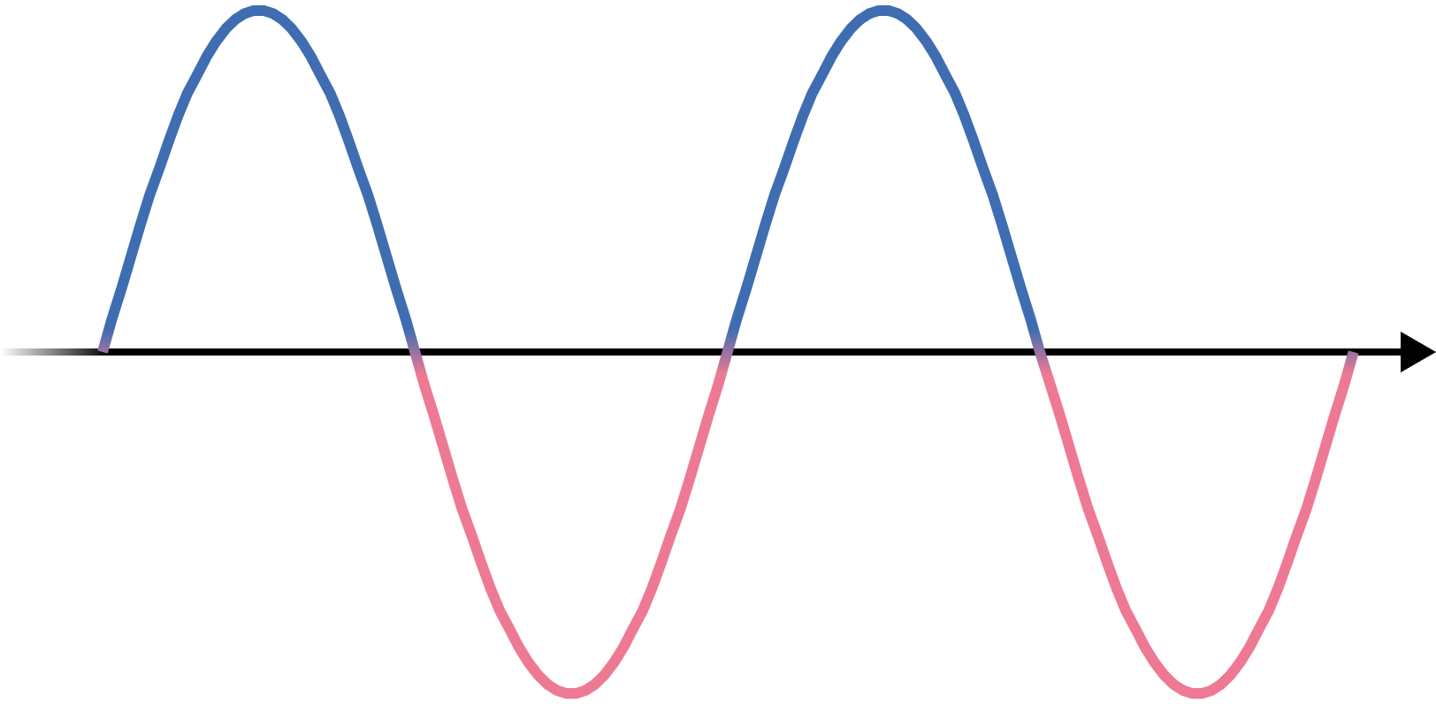
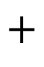
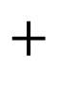
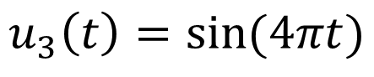
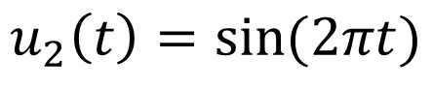
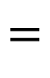
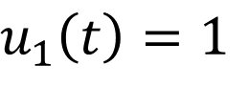


1. SPECTRAL GRAPH THEORY: The Classical Fourier Transform
$$u_{1}\left(t\right)=1$$
$$+$$
$$=$$
$$u_{2}\left(t\right)=sin⁡(2πt)$$
$$+$$
$$f: ℝ→ℝ$$
$$t⟼\int{\hat{f}(ξ){ u}_{ξ}(t)dξ}$$
$$u_{3}\left(t\right)=sin⁡(4πt)$$
$$…$$

Slide 8
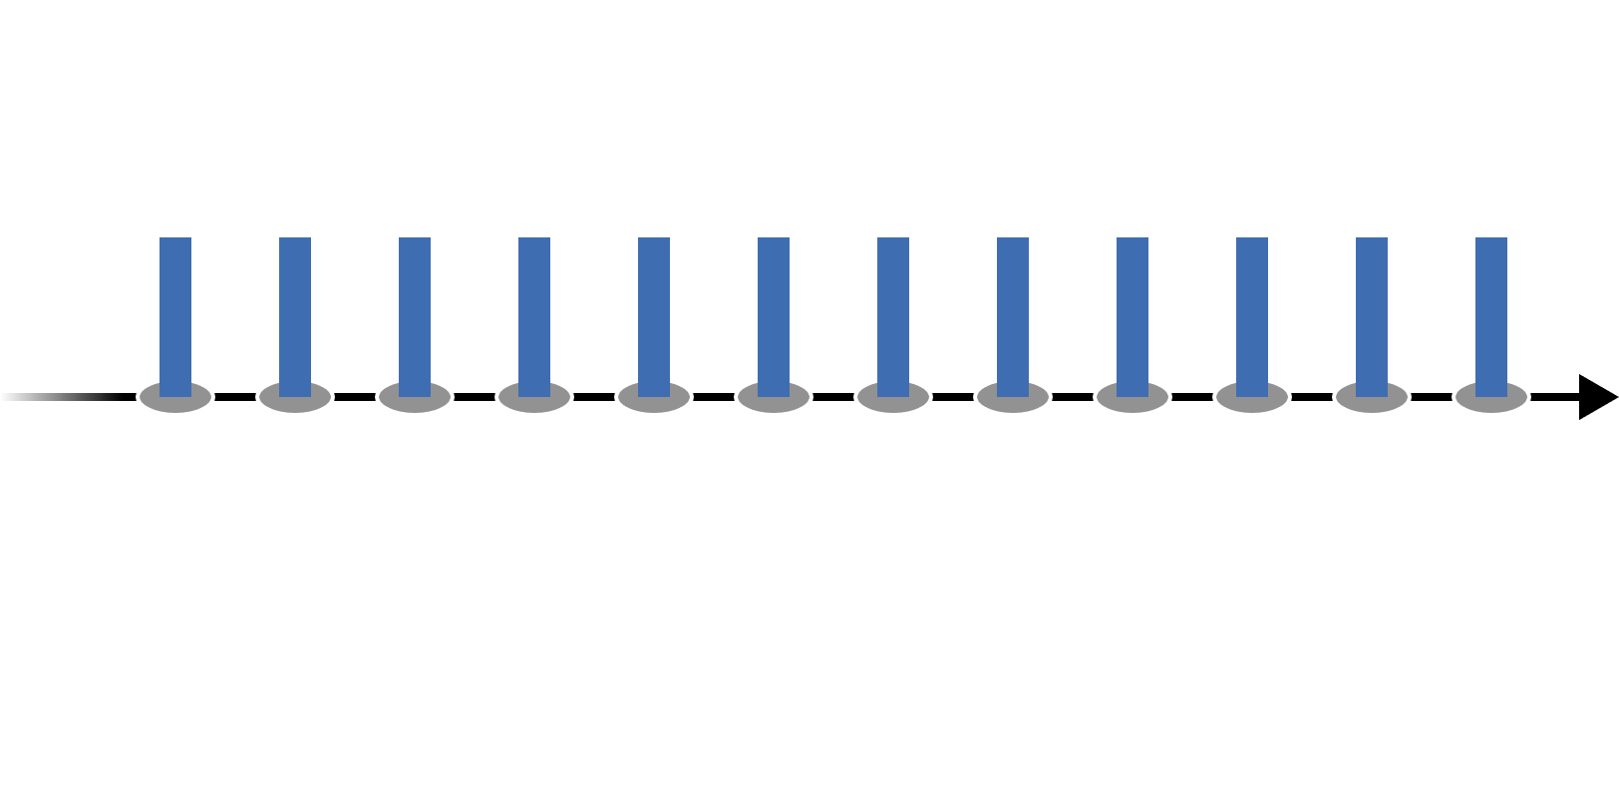
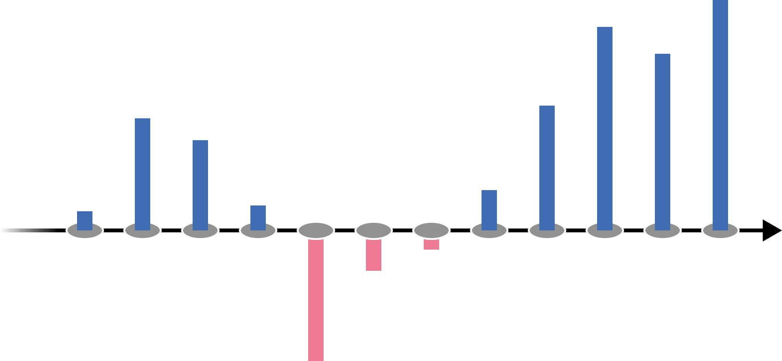
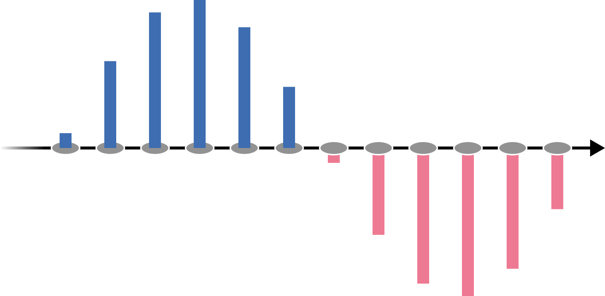
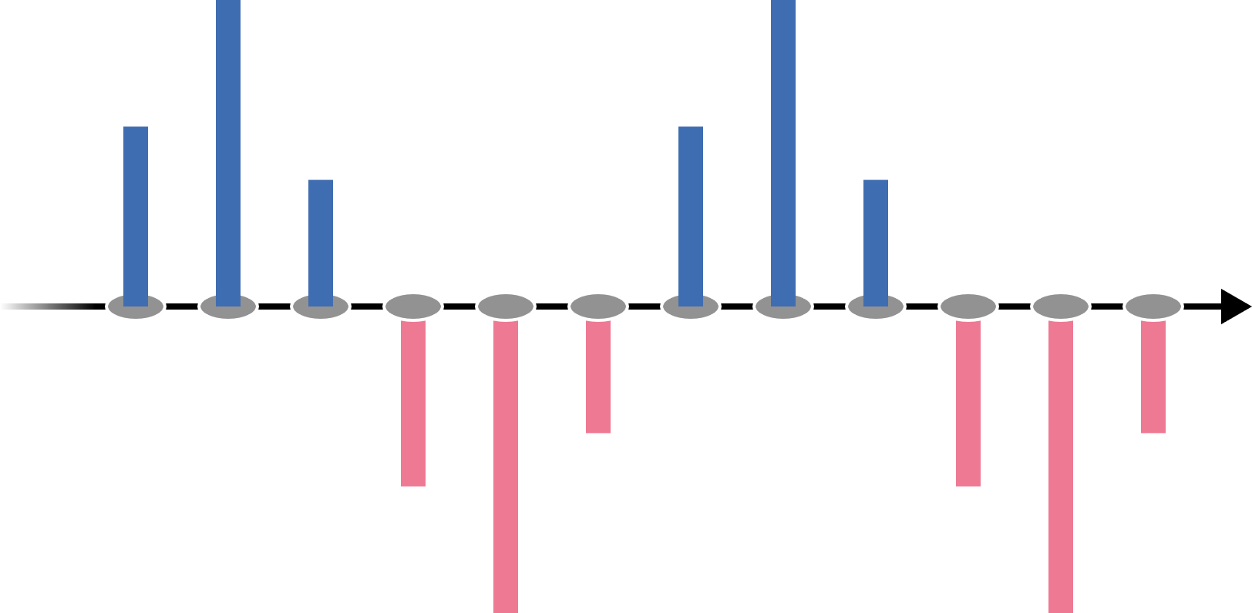
1. SPECTRAL GRAPH THEORY: Real-valued Functions as Graph Signals
$$u_{1}\left(t\right)=1$$
$$+$$
$$=$$
$$u_{2}\left(t\right)=sin⁡(2πt)$$
$$+$$
$$f: ℝ→ℝ$$
$$t⟼\int{\hat{f}(ξ){ u}_{ξ}(t)dξ}$$
$$u_{3}\left(t\right)=sin⁡(4πt)$$
$$…$$

Slide 9
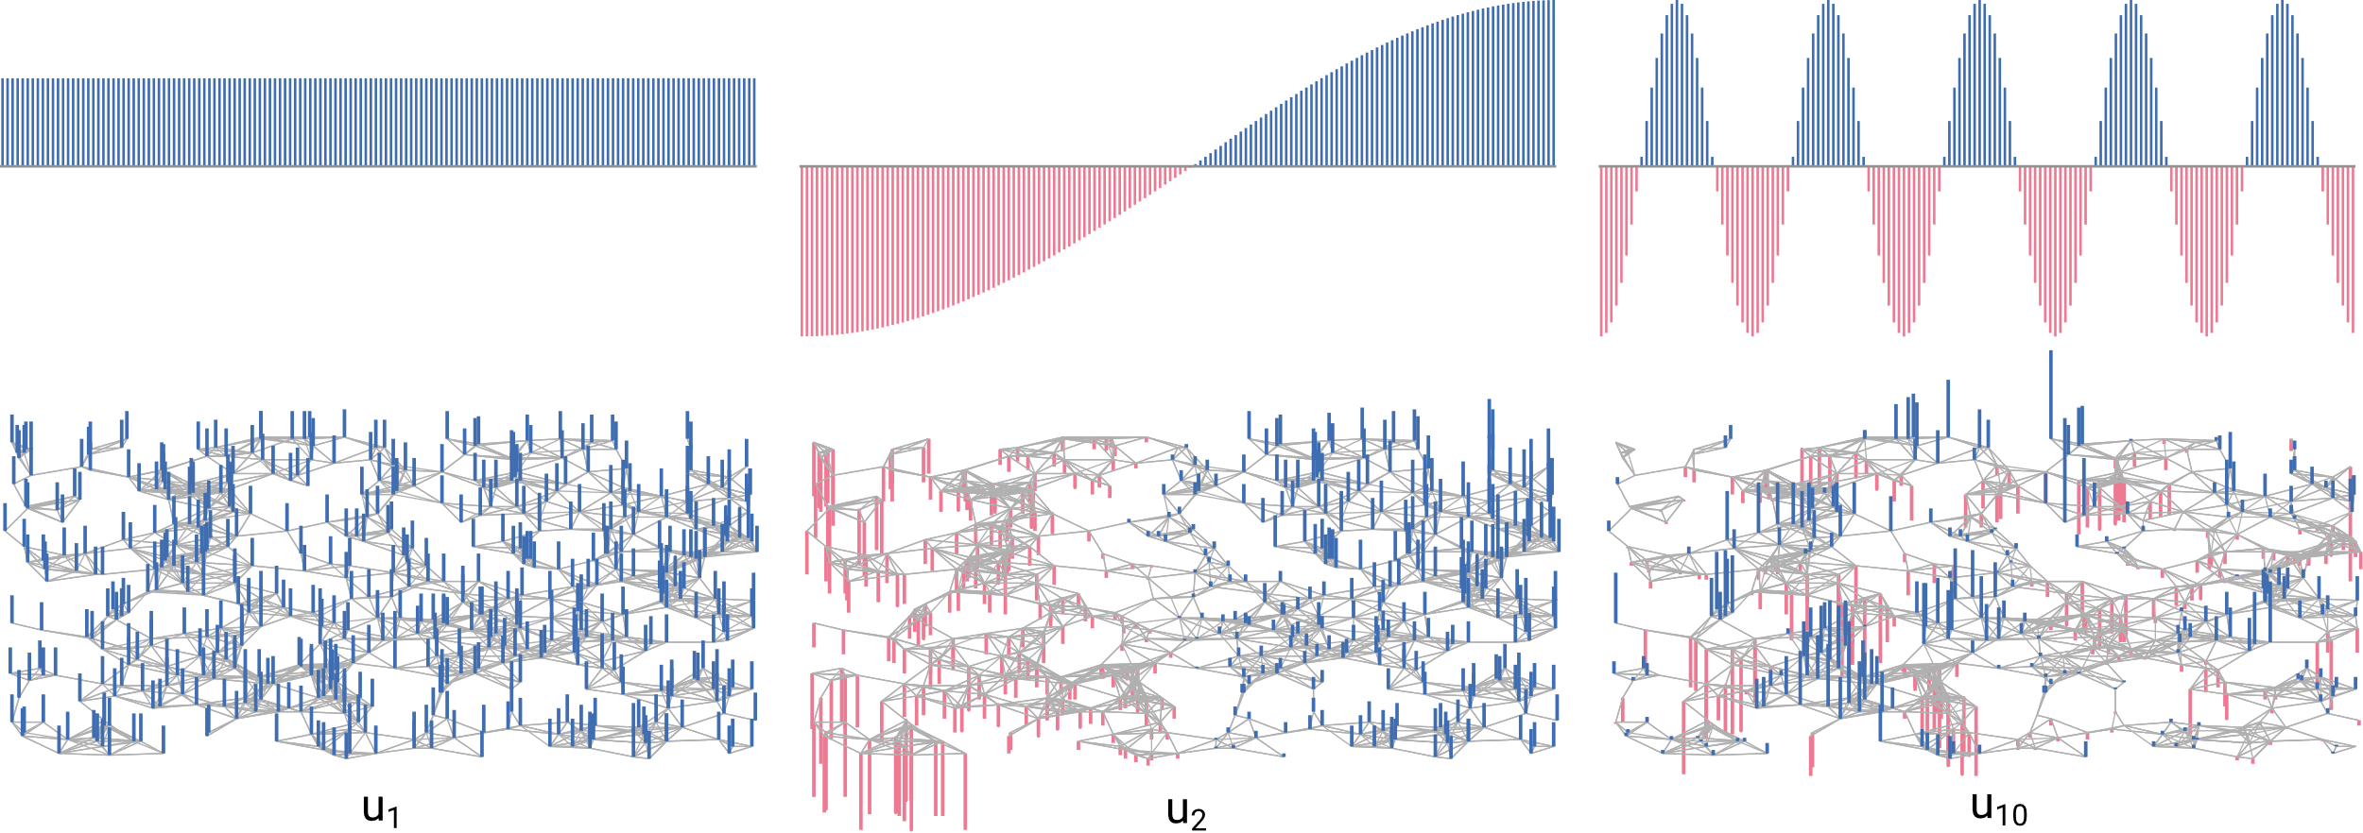
1. SPECTRAL GRAPH THEORY: Laplacian Eigenvectors

Slide 10
OVERVIEW
1. Spectral Graph Theory
2. How to coarsen a graph?
3.
What is the effect of coarsening?

Slide 11
OVERVIEW
1. Spectral Graph Theory
2. REC Coarsening
3.
What is the effect of coarsening?

